Slide 1
1
Accounting in Action
Learning Objectives
1
Identify the activities and users associated with accounting.
2
Explain the building blocks of accounting: ethics, principles, and assumptions.
3
State the accounting equation, and define its components.
4
Analyze the effects of business transactions on the accounting equation.
5
Describe the four financial statements and how they are
prepared.

Slide 2
LEARNING
OBJECTIVE
Identify the activities and users
associated with accounting.
1
Accounting consists of three basic activities—it
identifies,
records, and
communicates
the economic events of an organization to interested users.
LO 1

Slide 3
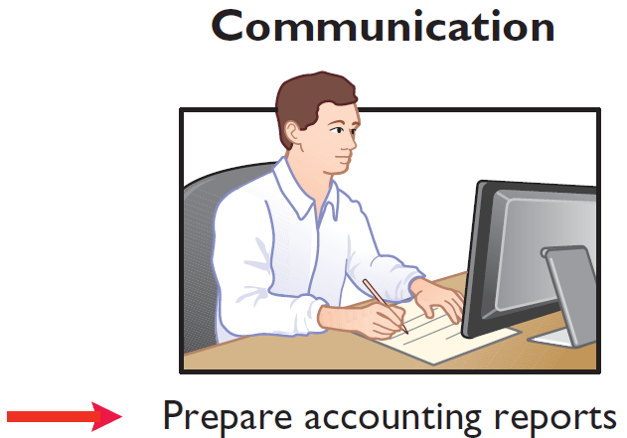
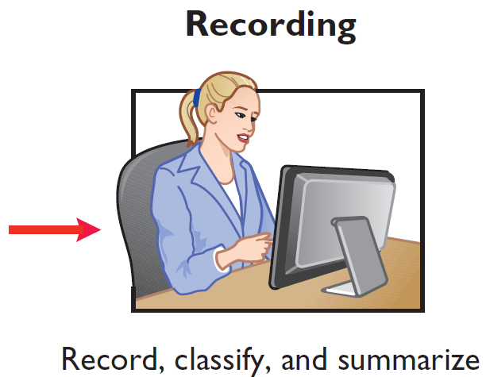
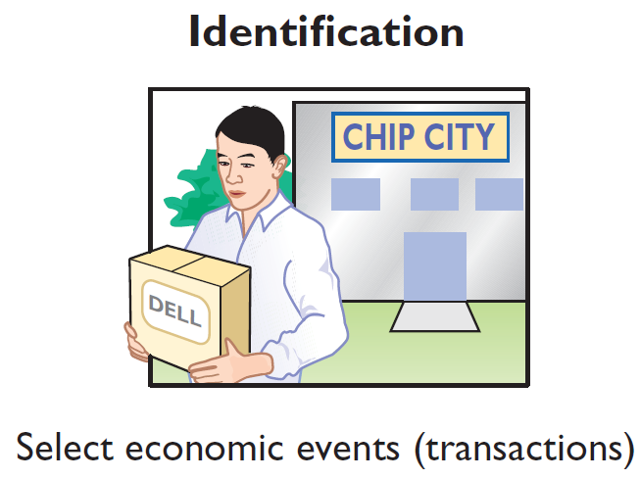
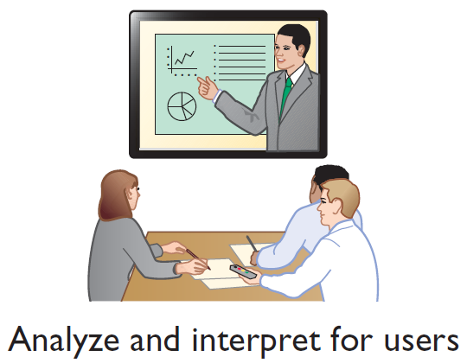
Three Activities
Illustration 1-1
The activities of the accounting process
The accounting process includes
the bookkeeping function.
LO 1

Slide 4
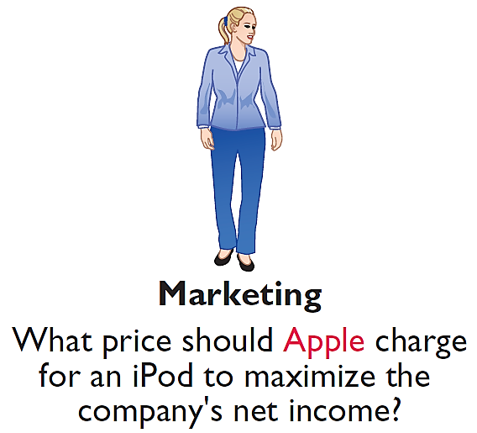
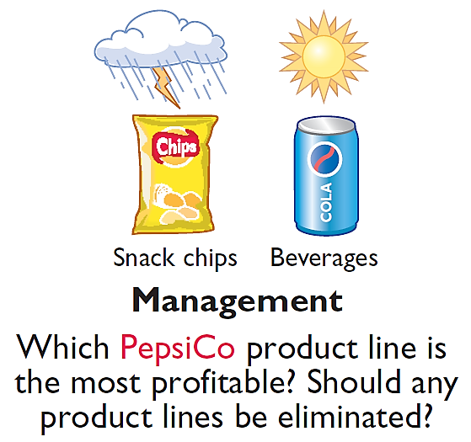
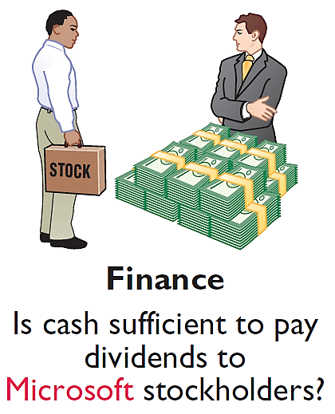
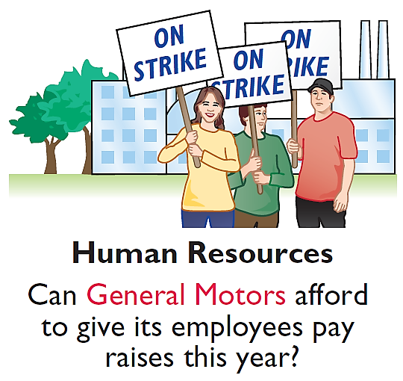
Who Uses Accounting Data
INTERNAL USERS
Illustration 1-2
Questions that internal users ask
LO 1

Slide 5
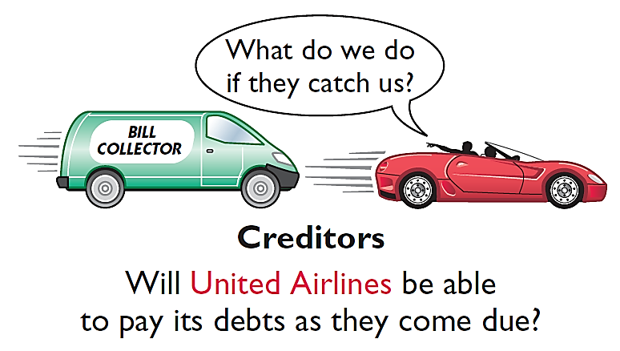
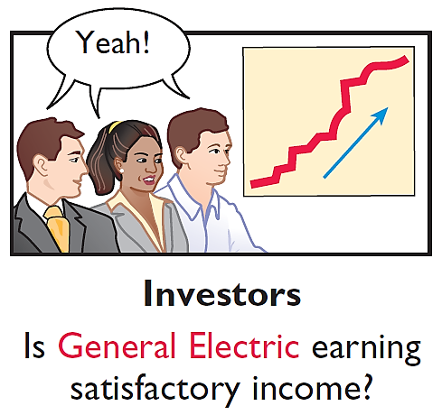
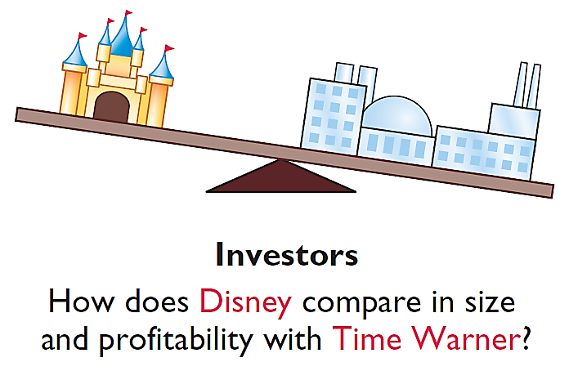
Who Uses Accounting Data
EXTERNAL USERS
Illustration 1-3
Questions that external users ask
LO 1

Slide 6
DO IT!
1
1
Basic Concepts
Indicate whether the following statements are true or false.
The three steps in the accounting process are identification, recording, and communication.
Bookkeeping encompasses all steps in the accounting process.
Accountants prepare, but do not interpret, financial reports.
The two most common types of external users are investors and company officers.
Managerial accounting activities focus on reports for internal users.
True
False
False
False
True
Solution: 1. 2. 3. 4. 5.
LO 1

Slide 7
LEARNING
OBJECTIVE
Explain the building blocks of accounting: ethics, principles, and assumptions.
2
Ethics in Financial Reporting
Recent financial scandals include: Enron, WorldCom, HealthSouth, AIG, and other companies.
Regulators and lawmakers concerned that economy would suffer if investors lost confidence in corporate accounting. In response,
Congress passed Sarbanes-Oxley Act (SOX).
Effective financial reporting depends on sound ethical behavior.
LO 2

Slide 8
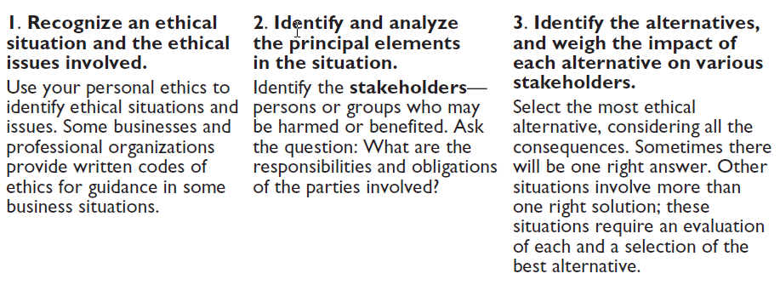
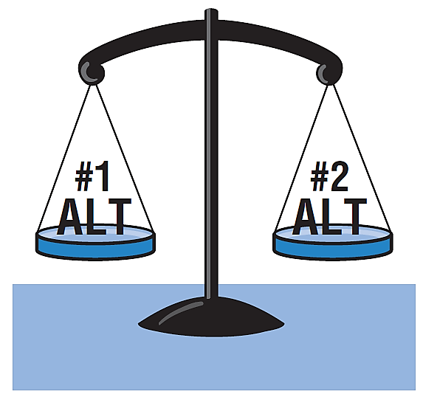
Ethics in Financial Reporting
Illustration 1-4
Steps in analyzing ethics cases and situations
LO 2

Slide 9
Ethics in Financial Reporting
Question
Ethics are the standards of conduct by which one's actions are judged as:
right or wrong.
honest or dishonest.
fair or not fair.
all of these options.
LO 2

Slide 10
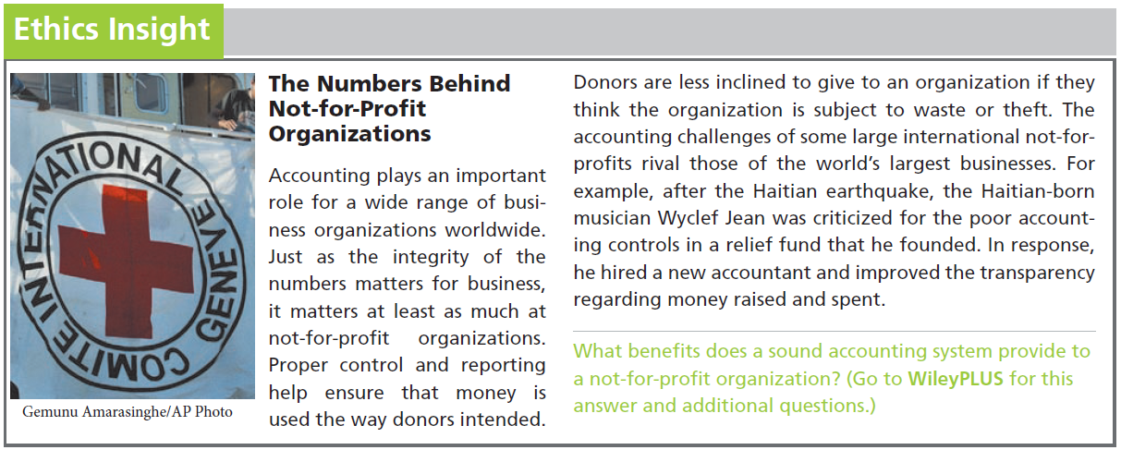
LO 2

Slide 11
Generally Accepted Accounting Principles
Financial Statements
Balance Sheet
Income Statement
Statement of Owner's Equity
Statement of Cash Flows
Note Disclosure
Various users need financial information
The accounting profession has developed standards that are generally accepted and universally practiced.
Generally Accepted Accounting Principles (GAAP)
LO 2

Slide 12
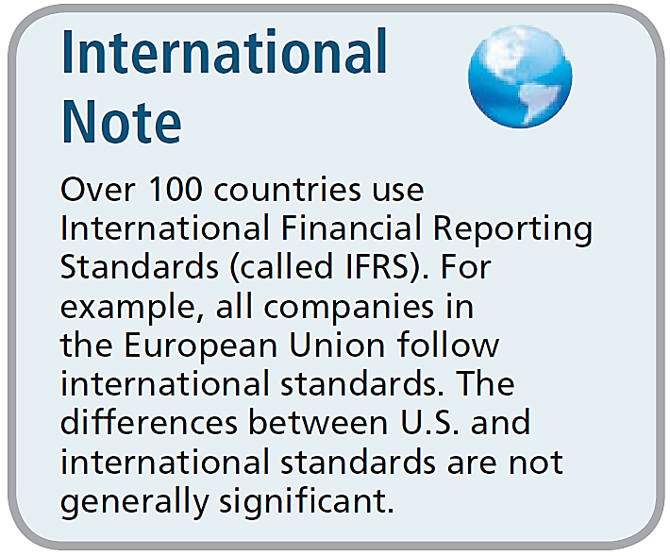
Generally Accepted Accounting Principles
Generally Accepted Accounting Principles (GAAP) – Standards that are generally accepted and universally practiced. These standards indicate how to report economic events.
Standard-setting bodies:
Financial Accounting Standards Board (FASB)
Securities and Exchange Commission (SEC)
International Accounting Standards Board (IASB)
LO 2

Slide 13
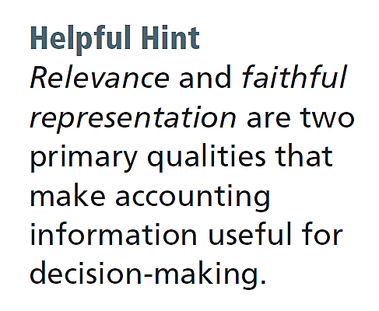
Measurement Principles
HISTORICAL COST PRINCIPLE (or cost principle) dictates that companies record assets at their cost.
FAIR VALUE PRINCIPLE states that assets and liabilities should be reported at fair value (the price received to sell an asset or settle a liability).
Selection of which principle to follow generally relates to trade-offs between relevance and faithful representation.
LO 2

Slide 14
Assumptions
MONETARY UNIT ASSUMPTION requires that companies include in the accounting records only transaction data that can be expressed in terms of money.
ECONOMIC ENTITY ASSUMPTION requires that activities of the entity be kept separate and distinct from the activities of its owner and all other economic entities.
Proprietorship
Partnership
Corporation
Forms of Business Ownership
LO 2

Slide 15
Forms of Business Ownership
Proprietorship
Partnership
Corporation
Owned by one person
Owner is often manager/operator
Owner receives any profits, suffers any losses, and is personally liable for all debts
Owned by two or more persons
Often retail and service-type businesses
Generally unlimited personal liability
Partnership agreement
Ownership divided into shares of stock
Separate legal entity organized under state corporation law
Limited liability
LO 2

Slide 16
Assumptions
Question
Combining the activities of Kellogg and General Mills would violate the
cost principle.
economic entity assumption.
monetary unit assumption.
ethics principle.
LO 2

Slide 17
Assumptions
Question
A business organized as a separate legal entity under state law having ownership divided into shares of stock is a
proprietorship.
partnership.
corporation.
sole proprietorship.
LO 2

Slide 18
DO IT!
2
Building Blocks of Accounting
Indicate whether each of the following statements presented below is true or false.
Congress passed the Sarbanes-Oxley Act to reduce unethical behavior and decrease the likelihood of future corporate scandals.
The primary accounting standard-setting body in the United States is the Financial Accounting Standards Board (FASB).
The historical cost principle dictates that companies record assets at their cost. In later periods, however, the fair value of the asset must be used if fair value is higher than its cost.
True
True
False
LO 2

Slide 19
DO IT!
2
Building Blocks of Accounting
Indicate whether each of the following statements presented below is true or false.
Relevance means that financial information matches what really happened; the information is factual.
A business owner’s personal expenses must be separated from expenses of the business to comply with accounting’s economic entity assumption.
False
True
LO 2

Slide 20
LEARNING
OBJECTIVE
State the accounting equation, and define its components.
3
Assets
Liabilities
Owner's Equity
=
+
Basic Accounting Equation
Provides the underlying framework for recording and summarizing economic events.
Assets are claimed by either creditors or owners.
If a business is liquidated, claims of creditors must be paid before ownership claims.
LO 3

Slide 21
Basic Accounting Equation
Assets
Liabilities
Owner's Equity
=
+
Assets
Resources a business owns.
Provide future services or benefits.
Cash, Supplies, Equipment, etc.
LO 3

Slide 22
Basic Accounting Equation
Assets
Liabilities
Owner's Equity
=
+
Liabilities
Claims against assets (debts and obligations).
Creditors (party to whom money is owed).
Accounts Payable, Notes Payable, Salaries and Wages Payable, etc.
LO 3

Slide 23
Basic Accounting Equation
Assets
Liabilities
Owner's Equity
=
+
Owner's Equity
Ownership claim on total assets.
Referred to as residual equity.
Investment by owners and revenues (+)
Drawings and expenses (-).
LO 3

Slide 24
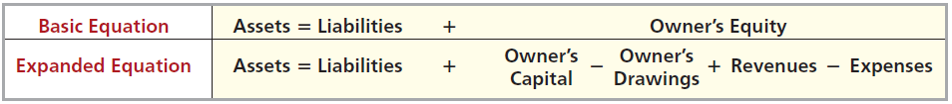
Owner’s Equity
Illustration 1-6
Expanded accounting equation
Increases in Owner’s Equity
Investments by owner are the assets the owner puts into the business.
Revenues result from business activities entered into for the purpose of earning income.
Common sources of revenue are: sales, fees, services, commissions, interest, dividends, royalties, and rent.
LO 3

Slide 25
Owner’s Equity
Illustration 1-6
Expanded accounting equation
Decreases in Owner’s Equity
Drawings An owner may withdraw cash or other assets for personal use.
Expenses are the cost of assets consumed or services used in the process of earning revenue.
Common expenses are: salaries expense, rent expense, utilities expense, tax expense, etc.
LO 3

Slide 26
DO IT!
3
Owner's Equity Effects
Classify the following items as investment by owner, owner’s drawings, revenue, or expenses. Then indicate whether each item increases or decreases owner’s equity.
Classification
Effect on Equity
Rent Expense
Service Revenue
Drawings
Salaries and Wages Expense
Expense
Decrease
Revenue
Increase
Drawings
Decrease
Expense
Decrease
LO 3

Slide 27
LEARNING
OBJECTIVE
Analyze the effects of business transactions on the accounting equation.
4
Transactions are a business’s economic events recorded by accountants.
May be external or internal.
Not all activities represent transactions.
Each transaction has a dual effect on the accounting equation.
LO 4

Slide 28


Transaction Analysis
Illustration: Are the following events recorded in the accounting records?
Illustration 1-7
Discuss product design with potential customer
Purchase computer
Event
Pay rent
Criterion
Is the financial position (assets, liabilities, or owner’s equity) of the company changed?
Record/
Don’t Record
LO 4

Slide 29
Transaction Analysis
TRANSACTION 1. INVESTMENT BY OWNER Ray Neal decides to start a smartphone app development company which he names Softbyte. On September 1, 2017, he invests $15,000 cash in the business. This transaction results in an equal increase in assets and owner’s equity.
Assets = Liabilities + Owner's Equity
Trans-
action
Cash
+
Accounts
Receivable
+
Supplies
+
Equipment
=
Accounts
Payable
+
Owner's Capital
+
Owner's Drawings
+
Rev.
-
Exp.
1. +15,000 +15,000
Illustration 1-8
Tabular summary of Softbyte transactions
LO 4

Slide 30
TRANSACTION 2. PURCHASE OF EQUIPMENT FOR CASH Softbyte Inc. purchases computer equipment for $7,000 cash.
Illustration 1-8
Assets = Liabilities + Owner's Equity
Trans-
action
Cash
+
Accounts
Receivable
+
Supplies
+
Equipment
=
Accounts
Payable
+
Owner's Capital
+
Owner's Drawings
+
Rev.
-
Exp.
1. +15,000 +15,000
2. -7,000 +7,000
3. +1,600 +1,600
4. +1,200 +1,200
5. +250 -250
6. +1,500 +2,000 +3,500
7. -1,700 -600
-900
-200
8. -250 -250
9. +600 -600
10. -1,300 -1,300
+
+
+
=
+
+
-
-
$8,050 $1,400 $1,600 $7,000 $1,600 $15,000 $4,700 $1,950 $1,300
LO 4

Slide 31
TRANSACTION 3. PURCHASE OF SUPPLIES ON CREDIT Softbyte Inc. purchases for $1,600 headsets and other accessories expected to last several months. The supplier allows Softbyte to pay this bill in October.
Illustration 1-8
Assets = Liabilities + Owner's Equity
Trans-
action
Cash
+
Accounts
Receivable
+
Supplies
+
Equipment
=
Accounts
Payable
+
Owner's Capital
+
Owner's Drawings
+
Rev.
-
Exp.
1. +15,000 +15,000
2. -7,000 +7,000
3. +1,600 +1,600
4. +1,200 +1,200
5. +250 -250
6. +1,500 +2,000 +3,500
7. -1,700 -600
-900
-200
8. -250 -250
9. +600 -600
10. -1,300 -1,300
+
+
+
=
+
+
-
-
$8,050 $1,400 $1,600 $7,000 $1,600 $15,000 $4,700 $1,950 $1,300
LO 4

Slide 32
TRANSACTION 4. SERVICES PERFORMED FOR CASH Softbyte Inc. receives $1,200 cash from customers for app development services it has performed.
Illustration 1-8
Assets = Liabilities + Owner's Equity
Trans-
action
Cash
+
Accounts
Receivable
+
Supplies
+
Equipment
=
Accounts
Payable
+
Owner's Capital
+
Owner's Drawings
+
Rev.
-
Exp.
1. +15,000 +15,000
2. -7,000 +7,000
3. +1,600 +1,600
4. +1,200 +1,200
5. +250 -250
6. +1,500 +2,000 +3,500
7. -1,700 -600
-900
-200
8. -250 -250
9. +600 -600
10. -1,300 -1,300
+
+
+
=
+
+
-
-
$8,050 $1,400 $1,600 $7,000 $1,600 $15,000 $4,700 $1,950 $1,300
LO 4

Slide 33
TRANSACTION 5. PURCHASE OF ADVERTISING ON CREDIT Softbyte Inc. receives a bill for $250 from the Daily News for advertising on its online website but postpones payment until a later date.
Illustration 1-8
Assets = Liabilities + Owner's Equity
Trans-
action
Cash
+
Accounts
Receivable
+
Supplies
+
Equipment
=
Accounts
Payable
+
Owner's Capital
+
Owner's Drawings
+
Rev.
-
Exp.
1. +15,000 +15,000
2. -7,000 +7,000
3. +1,600 +1,600
4. +1,200 +1,200
5. +250 -250
6. +1,500 +2,000 +3,500
7. -1,700 -600
-900
-200
8. -250 -250
9. +600 -600
10. -1,300 -1,300
+
+
+
=
+
+
-
-
$8,050 $1,400 $1,600 $7,000 $1,600 $15,000 $4,700 $1,950 $1,300
LO 4

Slide 34
TRANSACTION 6. SERVICES PERFORMED FOR CASH AND CREDIT. Softbyte performs $3,500 of services. The company receives cash of $1,500 from customers, and it bills the balance of $2,000 on account.
Illustration 1-8
Assets = Liabilities + Owner's Equity
Trans-
action
Cash
+
Accounts
Receivable
+
Supplies
+
Equipment
=
Accounts
Payable
+
Owner's Capital
+
Owner's Drawings
+
Rev.
-
Exp.
1. +15,000 +15,000
2. -7,000 +7,000
3. +1,600 +1,600
4. +1,200 +1,200
5. +250 -250
6. +1,500 +2,000 +3,500
7. -1,700 -600
-900
-200
8. -250 -250
9. +600 -600
10. -1,300 -1,300
+
+
+
=
+
+
-
-
$8,050 $1,400 $1,600 $7,000 $1,600 $15,000 $4,700 $1,950 $1,300
LO 4

Slide 35
TRANSACTION 7. PAYMENT OF EXPENSES Softbyte Inc. pays the following expenses in cash for September: office rent $600, salaries and wages of employees $900, and utilities $200.
Illustration 1-8
Assets = Liabilities + Owner's Equity
Trans-
action
Cash
+
Accounts
Receivable
+
Supplies
+
Equipment
=
Accounts
Payable
+
Owner's Capital
+
Owner's Drawings
+
Rev.
-
Exp.
1. +15,000 +15,000
2. -7,000 +7,000
3. +1,600 +1,600
4. +1,200 +1,200
5. +250 -250
6. +1,500 +2,000 +3,500
7. -1,700 -600
-900
-200
8. -250 -250
9. +600 -600
10. -1,300 -1,300
+
+
+
=
+
+
-
-
$8,050 $1,400 $1,600 $7,000 $1,600 $15,000 $4,700 $1,950 $1,300
LO 4

Slide 36
TRANSACTION 8. PAYMENT OF ACCOUNTS PAYABLE Softbyte Inc. pays its $250 Daily News bill in cash. The company previously (in Transaction 5) recorded the bill as an increase in Accounts Payable.
Illustration 1-8
Assets = Liabilities + Owner's Equity
Trans-
action
Cash
+
Accounts
Receivable
+
Supplies
+
Equipment
=
Accounts
Payable
+
Owner's Capital
+
Owner's Drawings
+
Rev.
-
Exp.
1. +15,000 +15,000
2. -7,000 +7,000
3. +1,600 +1,600
4. +1,200 +1,200
5. +250 -250
6. +1,500 +2,000 +3,500
7. -1,700 -600
-900
-200
8. -250 -250
9. +600 -600
10. -1,300 -1,300
+
+
+
=
+
+
-
-
$8,050 $1,400 $1,600 $7,000 $1,600 $15,000 $4,700 $1,950 $1,300
LO 4

Slide 37
TRANSACTION 9. RECEIPT OF CASH ON ACCOUNT Softbyte Inc. receives $600 in cash from customers who had been billed for services (in Transaction 6).
Illustration 1-8
Assets = Liabilities + Owner's Equity
Trans-
action
Cash
+
Accounts
Receivable
+
Supplies
+
Equipment
=
Accounts
Payable
+
Owner's Capital
+
Owner's Drawings
+
Rev.
-
Exp.
1. +15,000 +15,000
2. -7,000 +7,000
3. +1,600 +1,600
4. +1,200 +1,200
5. +250 -250
6. +1,500 +2,000 +3,500
7. -1,700 -600
-900
-200
8. -250 -250
9. +600 -600
10. -1,300 -1,300
+
+
+
=
+
+
-
-
$8,050 $1,400 $1,600 $7,000 $1,600 $15,000 $4,700 $1,950 $1,300
LO 4

Slide 38
TRANSACTION 10. WITHDRAWAL OF CASH BY OWNER Ray Neal withdraws $1,300 in cash in cash from the business for his personal use.
Illustration 1-8
Assets = Liabilities + Owner's Equity
Trans-
action
Cash
+
Accounts
Receivable
+
Supplies
+
Equipment
=
Accounts
Payable
+
Owner's Capital
+
Owner's Drawings
+
Rev.
-
Exp.
1. +15,000 +15,000
2. -7,000 +7,000
3. +1,600 +1,600
4. +1,200 +1,200
5. +250 -250
6. +1,500 +2,000 +3,500
7. -1,700 -600
-900
-200
8. -250 -250
9. +600 -600
10. -1,300 -1,300
+
+
+
=
+
+
-
-
$8,050 $1,400 $1,600 $7,000 $1,600 $15,000 $1,300 $4,700 $1,950
$18,050
$18,050
LO 4

Slide 39
Summary of Transactions
Each transaction is analyzed in terms of its effect on:
The three components of the basic accounting equation.
Specific of items within each component.
The two sides of the equation must always be equal.
LO 4

Slide 40
DO IT!
4
Tabular Analysis
Transactions made by Virmari & Co., a public accounting firm, for the month of August are shown below. Prepare a tabular analysis which shows the effects of these transactions on the expanded accounting equation, similar to that shown in Illustration 1-8.
The owner invested $25,000 cash in the business.
The company purchased $7,000 of office equipment on credit.
The company received $8,000 cash in exchange for services performed.
The company paid $850 for this month’s rent.
The owner withdrew $1,000 cash for personal use.
LO 4

Slide 41
DO IT!
4
Tabular Analysis
The owner invested $25,000 cash in the business.
Assets = Liabilities + Owner's Equity
Trans-
action
Cash
+
Equipment
=
Accounts
Payable
+
Owner's Capital
+
Owner's Drawings
+
Rev.
-
Exp.
1. +25,000 +25,000
2. +7,000 +7,000
3. +8,000 +8,000
4. -850 -850
5. -1,000 -1,000
+
=
+
+
-
-
$31,150 $7,000 $7,000 $25,000 $8,000 $850 $1,000
$18,050
$18,050
LO 4

Slide 42
DO IT!
4
Tabular Analysis
The company purchased $7,000 of office equipment on credit.
Assets = Liabilities + Owner's Equity
Trans-
action
Cash
+
Equipment
=
Accounts
Payable
+
Owner's Capital
+
Owner's Drawings
+
Rev.
-
Exp.
1. +25,000 +25,000
2. +7,000 +7,000
3. +8,000 +8,000
4. -850 -850
5. -1,000 -1,000
+
=
+
+
-
-
$31,150 $7,000 $7,000 $25,000 $8,000 $850 $1,000
$18,050
$18,050
LO 4

Slide 43
DO IT!
4
Tabular Analysis
The company received $8,000 cash in exchange for services performed.
Assets = Liabilities + Owner's Equity
Trans-
action
Cash
+
Equipment
=
Accounts
Payable
+
Owner's Capital
+
Owner's Drawings
+
Rev.
-
Exp.
1. +25,000 +25,000
2. +7,000 +7,000
3. +8,000 +8,000
4. -850 -850
5. -1,000 -1,000
+
=
+
+
-
-
$31,150 $7,000 $7,000 $25,000 $8,000 $850 $1,000
$18,050
$18,050
LO 4

Slide 44
DO IT!
4
Tabular Analysis
The company paid $850 for this month’s rent.
Assets = Liabilities + Owner's Equity
Trans-
action
Cash
+
Equipment
=
Accounts
Payable
+
Owner's Capital
+
Owner's Drawings
+
Rev.
-
Exp.
1. +25,000 +25,000
2. +7,000 +7,000
3. +8,000 +8,000
4. -850 -850
5. -1,000 -1,000
+
=
+
+
-
-
$31,150 $7,000 $7,000 $25,000 $8,000 $850 $1,000
$18,050
$18,050
LO 4

Slide 45
DO IT!
4
Tabular Analysis
The owner withdrew $1,000 cash for personal use.
Assets = Liabilities + Owner's Equity
Trans-
action
Cash
+
Equipment
=
Accounts
Payable
+
Owner's Capital
+
Owner's Drawings
+
Rev.
-
Exp.
1. +25,000 +25,000
2. +7,000 +7,000
3. +8,000 +8,000
4. -850 -850
5. -1,000 -1,000
+
=
+
+
+
-
$31,150 $7,000 $7,000 $25,000 $1,000 $8,000 $850
$38,150
$38,150
LO 4

Slide 46
LEARNING
OBJECTIVE
Describe the four financial statements
and how they are prepared.
5
Companies prepare four financial statements :
Income Statement
Owner’s Equity Statement
Balance Sheet
Statement of Cash Flows
LO 5

Slide 47
Financial Statements
Question
Net income will result during a time period when:
assets exceed liabilities.
assets exceed revenues.
expenses exceed revenues.
revenues exceed expenses.
LO 5

Slide 48
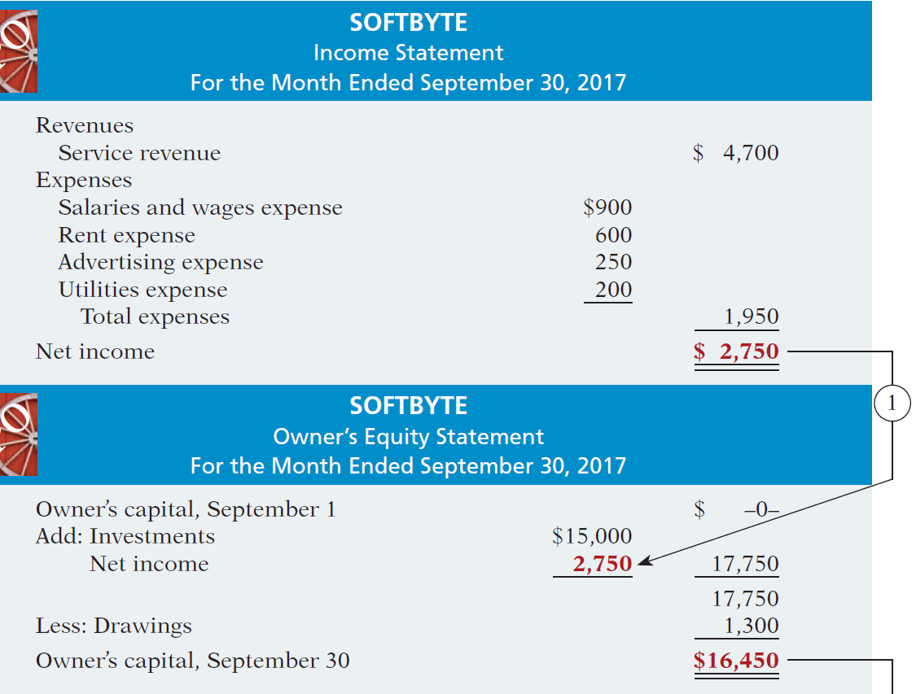
Net income is needed to determine the ending balance in owner’s equity.
Financial Statements
SOFTBYTE
Income Statement
For the Month Ended September 30, 2017
Illustration 1-9
Financial statements and
their interrelationships
SOFTBYTE
Owner’s Equity Statement
For the Month Ended September 30, 2017
LO 5

Slide 49
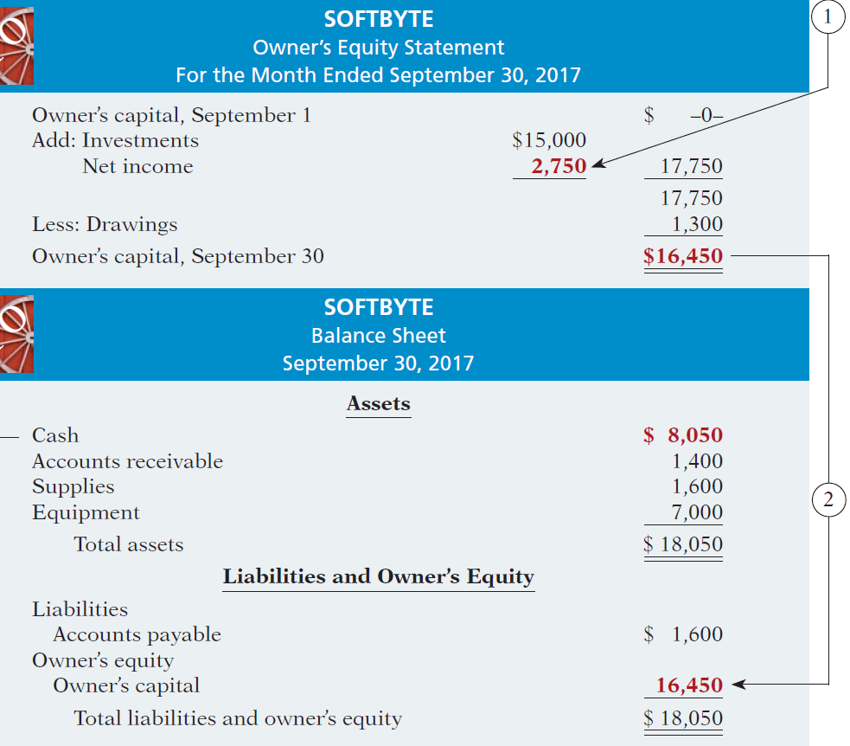
SOFTBYTE
Owner’s Equity Statement
For the Month Ended September 30, 2017
The ending balance in owner’s equity is needed in preparing the balance sheet.
Illustration 1-9
SOFTBYTE
Balance Sheet
September 30, 2017
Illustration 1-9
Financial statements and their interrelationships

Slide 50
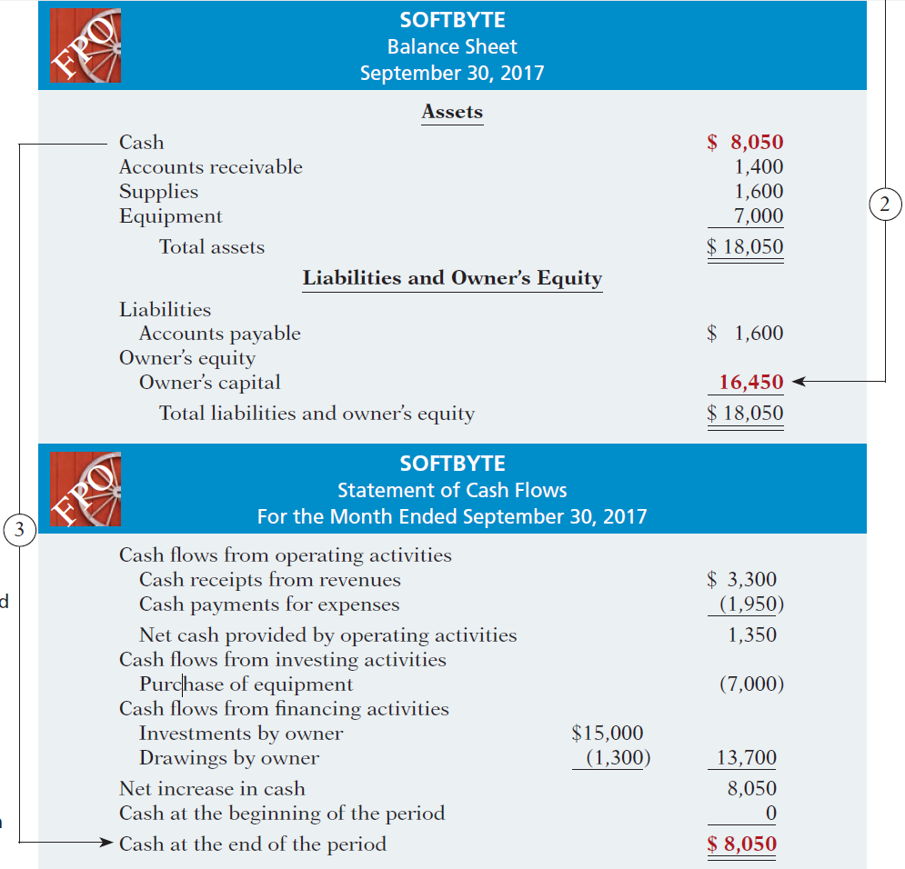
Financial Statements
SOFTBYTE
Balance Sheet
September 30, 2017
Balance sheet and income statement are needed to prepare statement of cash flows.
SOFTBYTE
Statement of Cash Flows
For the Month Ended September 30, 2017
Illustration 1-9
Financial statements and their interrelationships

Slide 51
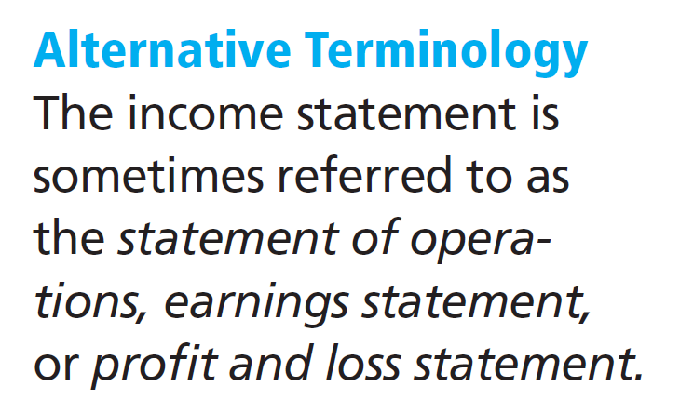
Income Statement
Reports the revenues and expenses for a specific period of time.
Lists revenues first, followed by expenses.
Shows net income (or net loss).
Does not include investment and withdrawal transactions between the owner and the business in measuring net income.
LO 5

Slide 52
Owner’s Equity Statement
Reports the changes in owner’s equity for a specific period of time.
The time period is the same as that covered by the income statement.
LO 5

Slide 53
Balance Sheet
Reports the assets, liabilities, and owner's equity at a specific date.
Lists assets at the top, followed by liabilities and owner’s equity.
Total assets must equal total liabilities and owner's equity.
Is a snapshot of the company’s financial condition at a specific moment in time (usually the month-end or year-end).
LO 5

Slide 54
Statement of Cash Flows
Information on the cash receipts and payments for a specific period of time.
Answers the following:
Where did cash come from?
What was cash used for?
What was the change in the
cash balance?
LO 5

Slide 55
Financial Statements
Question
Which of the following financial statements is prepared as of a specific date?
Balance sheet.
Income statement.
Owner's equity statement.
Statement of cash flows.
LO 5

Slide 56
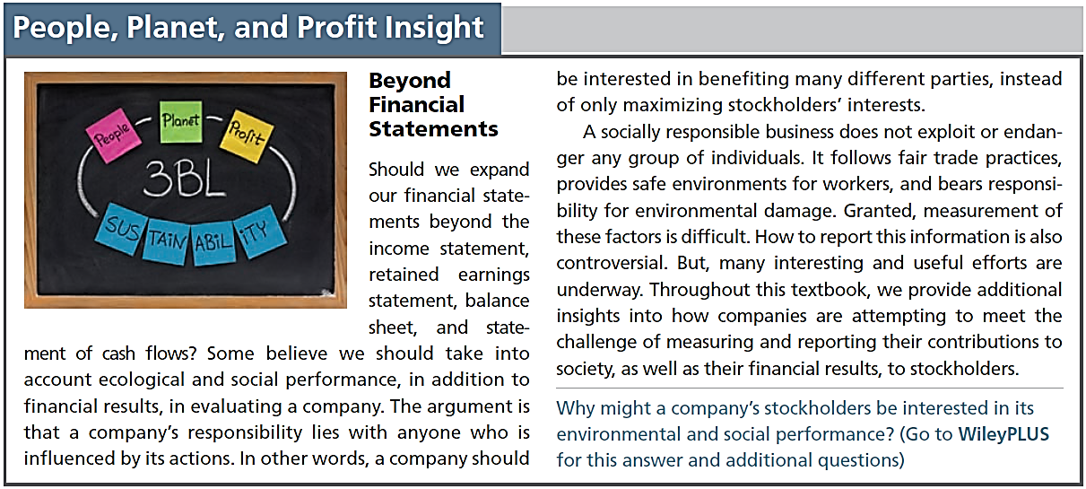
LO 5

Slide 57
DO IT!
5
Financial Statement Items
Presented below is selected information related to Flanagan Company at December 31, 2017. Flanagan reports financial information monthly.
Equipment $10,000 Utilities Expense $ 4,000
Cash 8,000 Accounts Receivable 9,000
Service Revenue 36,000 Salaries and Wages Expense 7,000
Rent Expense 11,000 Notes Payable 16,500
Accounts Payable 2,000 Owner’s Drawings 5,000
(a) Determine the total assets of at December 31, 2017.
(b) Determine the net income reported for December 2017.
(c) Determine the owner’s equity at December 31, 2017.
LO 5

Slide 58
DO IT!
5
Financial Statement Items
Presented below is selected information related to Flanagan Company at December 31, 2017. Flanagan reports financial information monthly.
Equipment $10,000 Utilities Expense $ 4,000
Cash 8,000 Accounts Receivable 9,000
Service Revenue 36,000 Salaries and Wages Expense 7,000
Rent Expense 11,000 Notes Payable 16,500
Accounts Payable 2,000 Owner’s Drawings 5,000
(a) Determine the total assets of at December 31, 2017.
The total assets are $27,000, comprised of
Cash $8,000,
Accounts Receivable $9,000, and
Equipment $10,000.
LO 5

Slide 59
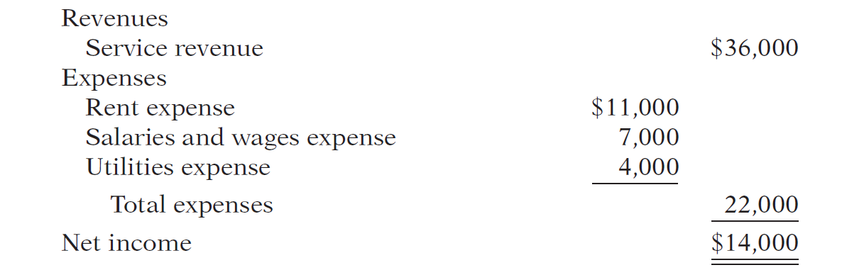
DO IT!
5
Financial Statement Items
Presented below is selected information related to Flanagan Company at December 31, 2017. Flanagan reports financial information monthly.
Equipment $10,000 Utilities Expense $ 4,000
Cash 8,000 Accounts Receivable 9,000
Service Revenue 36,000 Salaries and Wages Expense 7,000
Rent Expense 11,000 Notes Payable 16,500
Accounts Payable 2,000 Owner’s Drawings 5,000
(b) Determine the net income reported for December 2017.
LO 5

Slide 60
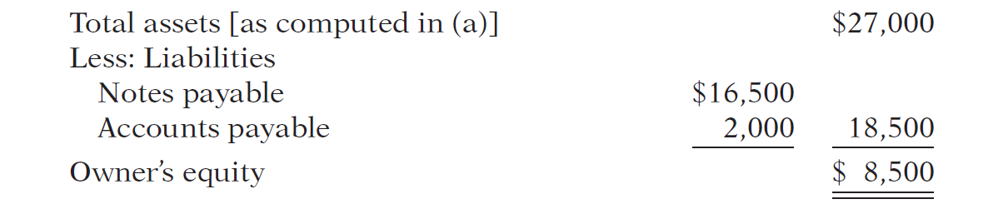
DO IT!
5
Financial Statement Items
Presented below is selected information related to Flanagan Company at December 31, 2017. Flanagan reports financial information monthly.
Equipment $10,000 Utilities Expense $ 4,000
Cash 8,000 Accounts Receivable 9,000
Service Revenue 36,000 Salaries and Wages Expense 7,000
Rent Expense 11,000 Notes Payable 16,500
Accounts Payable 2,000 Owner’s Drawings 5,000
(c) Determine the owner’s equity at December 31, 2017.
LO 5

Slide 61
LEARNING
OBJECTIVE
APPENDIX 1A: Explain the career opportunities in accounting.
6
Public Accounting
Careers in auditing, taxation, and management consulting serving the general public.
Private Accounting
Careers in industry working in cost accounting, budgeting, accounting information systems, and taxation.
Governmental Accounting
Careers with the IRS, the FBI, the SEC, public colleges and universities, and in state and local governments.
Forensic Accounting
Uses accounting, auditing, and investigative skills to conduct investigations into theft and fraud.
LO 6

Slide 62
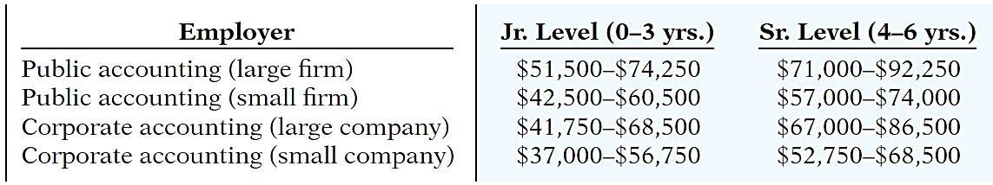
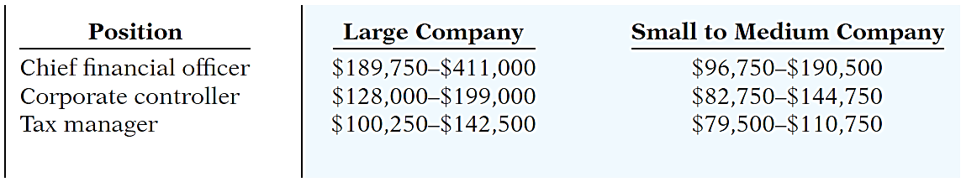
“Show Me the Money”
Salary estimates for jobs in public and corporate accounting
Illustration 1A-1
Upper-level management salaries in corporate accounting
Illustration 1A-2
LO 6

Slide 63

LEARNING
OBJECTIVE
Describe the impact of international accounting standards on U.S. financial reporting.
7
Key Points
Following are the key similarities and differences between GAAP and IFRS as related to accounting fundamentals.
Similarities
The basic techniques for recording business transactions are the same for U.S. and international companies.
Both international and U.S. accounting standards emphasize transparency in financial reporting. Both sets of standards are primarily driven by meeting the needs of investors and creditors.
LO 7

Slide 64
Key Points
Similarities
The three most common forms of business organizations, proprietorships, partnerships, and corporations, are also found in countries that use international accounting standards.
Differences
International standards are referred to as International Financial Reporting Standards (IFRS), developed by the International Accounting Standards Board. Accounting standards in the United States are referred to as generally accepted accounting principles (GAAP) and are developed by the Financial Accounting Standards Board.
LO 7

Slide 65
Key Points
Differences
IFRS tends to be simpler in its accounting and disclosure requirements; some people say it is more “principles-based.” GAAP is more detailed; some people say it is more “rules-based.”
The internal control standards applicable to Sarbanes-Oxley (SOX) apply only to large public companies listed on U.S. exchanges. There is continuing debate as to whether non-U.S. companies should have to comply with this extra layer of regulation.
LO 7

Slide 66
Looking to the Future
Both the IASB and the FASB are hard at work developing standards that will lead to the elimination of major differences in the way certain transactions are accounted for and reported.
LO 7

Slide 67
A Look at IFRS
IFRS Self-Test Questions
Which of the following is not a reason why a single set of high-quality international accounting standards would be beneficial?
Mergers and acquisition activity.
Financial markets.
Multinational corporations.
GAAP is widely considered to be a superior reporting system.
LO 7

Slide 68
A Look at IFRS
IFRS Self-Test Questions
The Sarbanes-Oxley Act determines:
international tax regulations.
internal control standards as enforced by the IASB.
internal control standards of U.S. publicly traded companies.
U.S. tax regulations.
LO 7

Slide 69
A Look at IFRS
IFRS Self-Test Questions
IFRS is considered to be more:
principles-based and less rules-based than GAAP.
rules-based and less principles-based than GAAP.
detailed than GAAP.
None of the above.
LO 7

Slide 70
Copyright
“Copyright © 2015 John Wiley & Sons, Inc. All rights reserved. Reproduction or translation of this work beyond that permitted in Section 117 of the 1976 United States Copyright Act without the express written permission of the copyright owner is unlawful. Request for further information should be addressed to the Permissions Department, John Wiley & Sons, Inc. The purchaser may make back-up copies for his/her own use only and not for distribution or resale. The Publisher assumes no responsibility for errors, omissions, or damages, caused by the use of these programs or from the use of the information contained herein.”

Slide 71
https://drive.google.com/file/d/1-5fS_FGcPnReN_iG9dNzehtO3ONFO58F/view?usp=drivesdk

